Slide 1

PCI Big Beam Contest
New Oriental
Junfeng Qian
Shiyu Wang
Qi Wang

Slide 2

Presentation Outline
Background
Contest Rules
Project Constrains
Scope of Service
Timeline

Slide 3

Background
Sponsored by PCI and Sika Corporation
PCI- Precast/Prestressed Concrete Institute
Contest Period: 8/15/2012 -6/15/2013.

Slide 4

Background Cont.
Judging Criteria
Design accuracy
Lowest cost
Lowest weight
Largest measured deflection at maximum total applied load
Report quality
Video

Slide 5
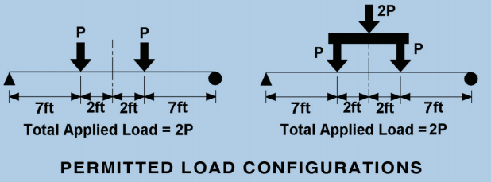
Contest Rules
The beam must no longer than 20 feet and must be tested as a simply supported span of 18 feet
The beam shall be designed for dead load plus two applied service live loads of 10 kips

Slide 6
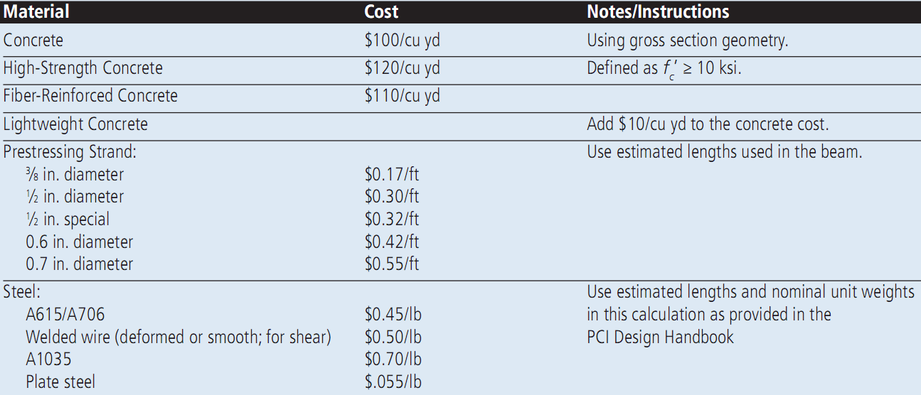
Contest Rules Cont.
All unit cost of available materials are provided by PCI
All entries must meet the provisions of ACI-318-08 or the 7th Edition of the PCI Design Handbook

Slide 7
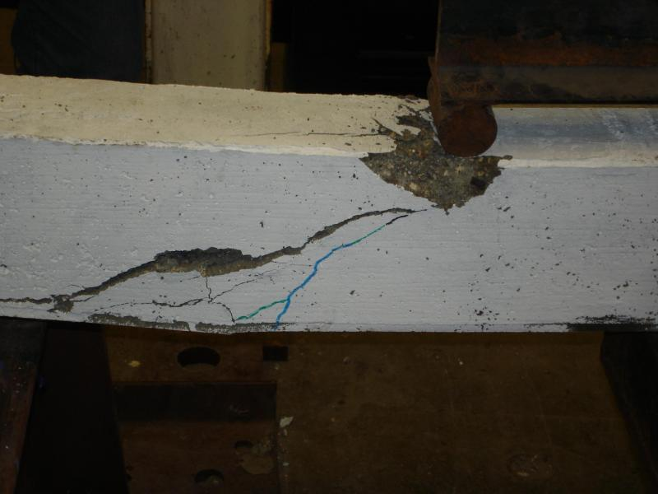
Scope of Service
Project Management
Background and Literature Search
Preliminary Analysis & Design
Final Analysis & Design
Testing Instrumentation Setting Up
Service During Fabrication
Beam Test
Design Report

Slide 8
Scope Of Service
Task 1-Project Management
Weekly Team Meeting
Update Design
Comments
Technical Coordination Meeting
Workshop
Meet with Project Manager of Sponsor Company

Slide 9
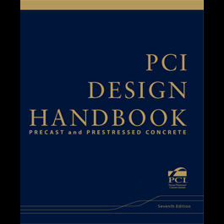

Scope of Service Cont.
Task 2-Literature Search
ACI-318-08
PCI Design Handbook, 7th Edition

Slide 10
Scope of Service Cont.
Task 3-Preliminary Analysis & Design
Material Selection
Concrete Mix
Lightweight Self Consolidating Concrete
Normal Self Consolidating Concrete
Reinforcement Bar
ASTM Standard #4 or #5
Design Spreadsheet
Design Matrix
Six to Eight Options

Slide 11
Scope of Service Cont.
Task 4-Final Analysis & Design
Final Option
Design Verification
Response 2000
Auto CAD Drawing
Cross Section View
Side View

Slide 12
Scope of Service Cont.
Task 5-Testing Instrumentation Setting Up
Task 6-Service during Fabrication
Troubleshooting
Task 7-Beam Test
Test Results
Video
Task 8-Design Report

Slide 13

Timeline

Slide 14

Reference
Acknowledge
Technical Advisor: Dr. Tuchscherer
Project Manager: David L. Chapin
Sponsor: Tpac Company
ACI Code 318-08
The 7th Edition of the PCI Design Handbook

Slide 15

Questions

Slide 16
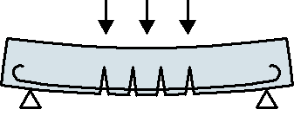
Thank you!

